Slide 1
Pattern Recognition
Project 1
Lukas Drexler, Leiv van Hollande, Reza Jahangiri, Mark Springer, Maximilian Thiessen

Slide 2

1. Task

Slide 3
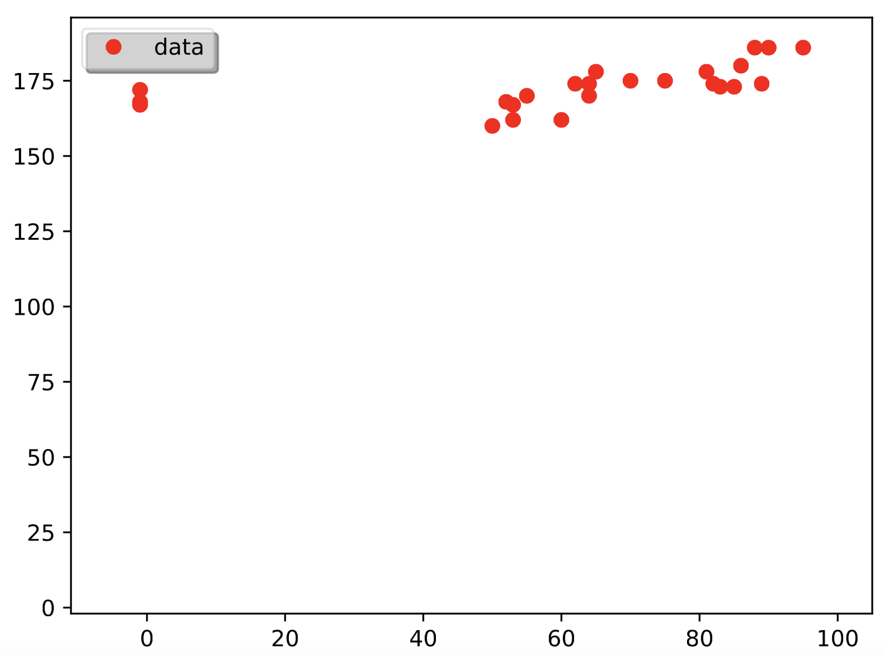
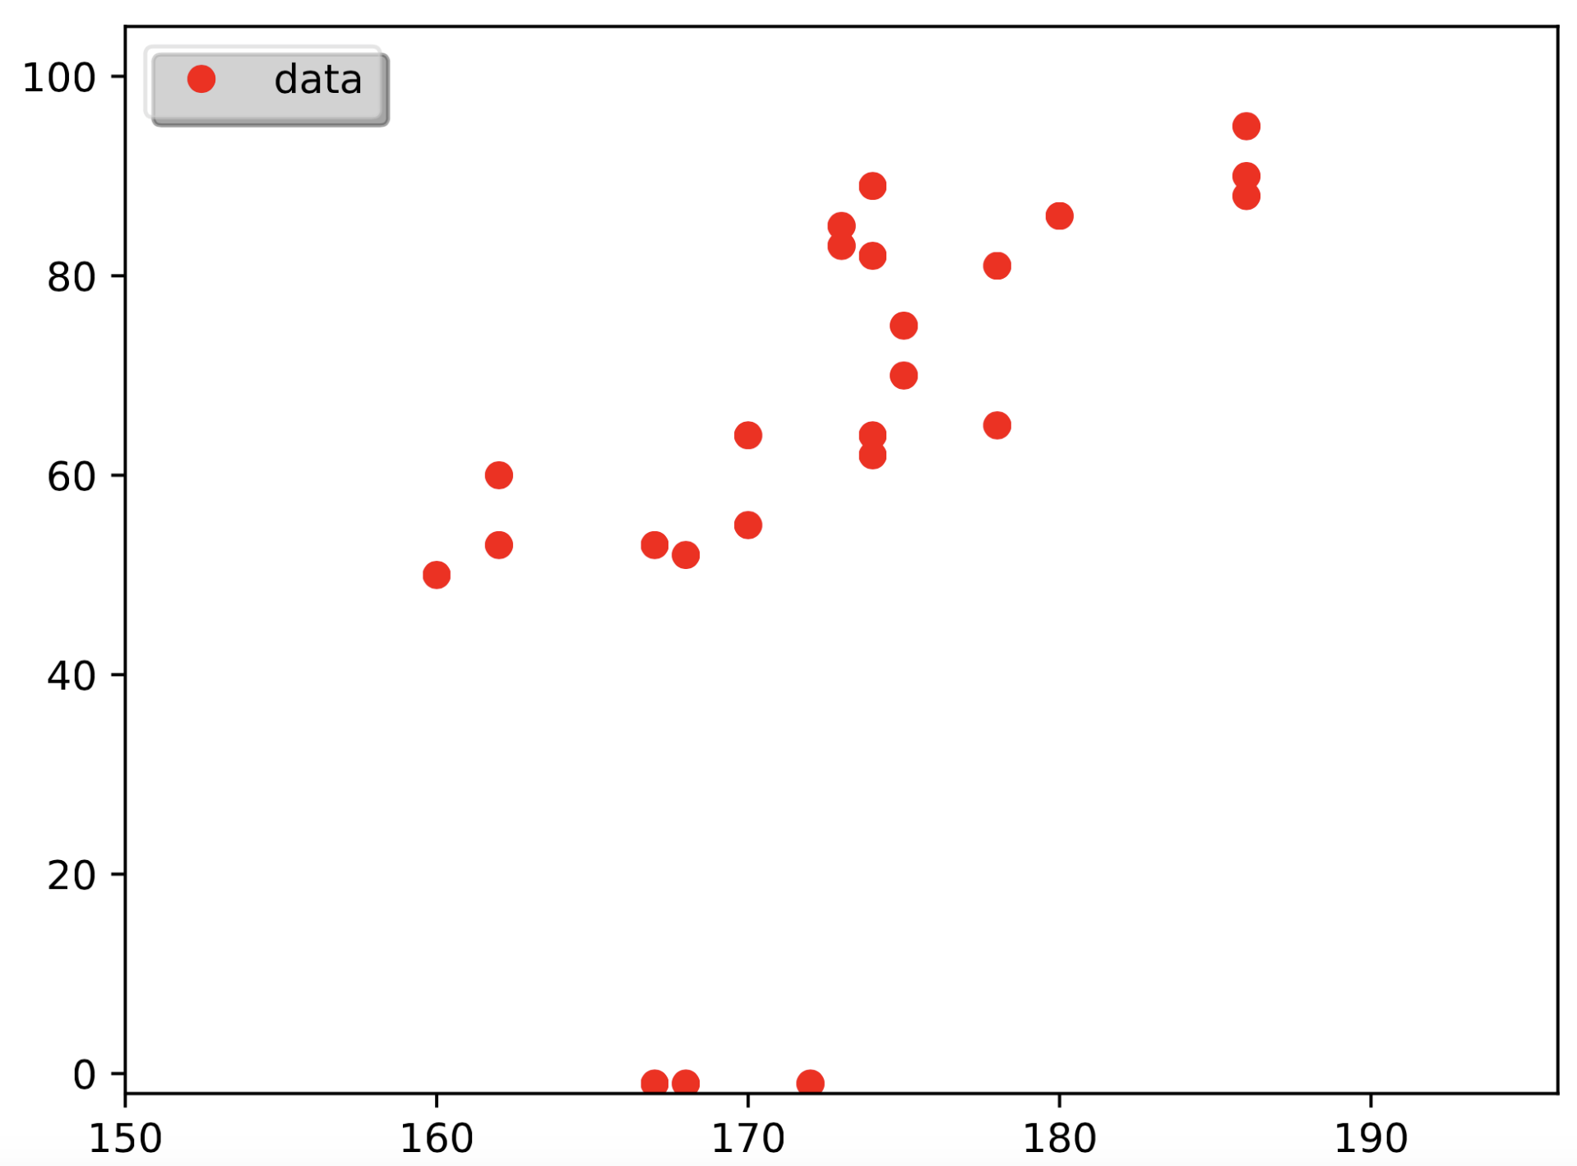
1. Task
Plot the data without the outliers

Slide 4
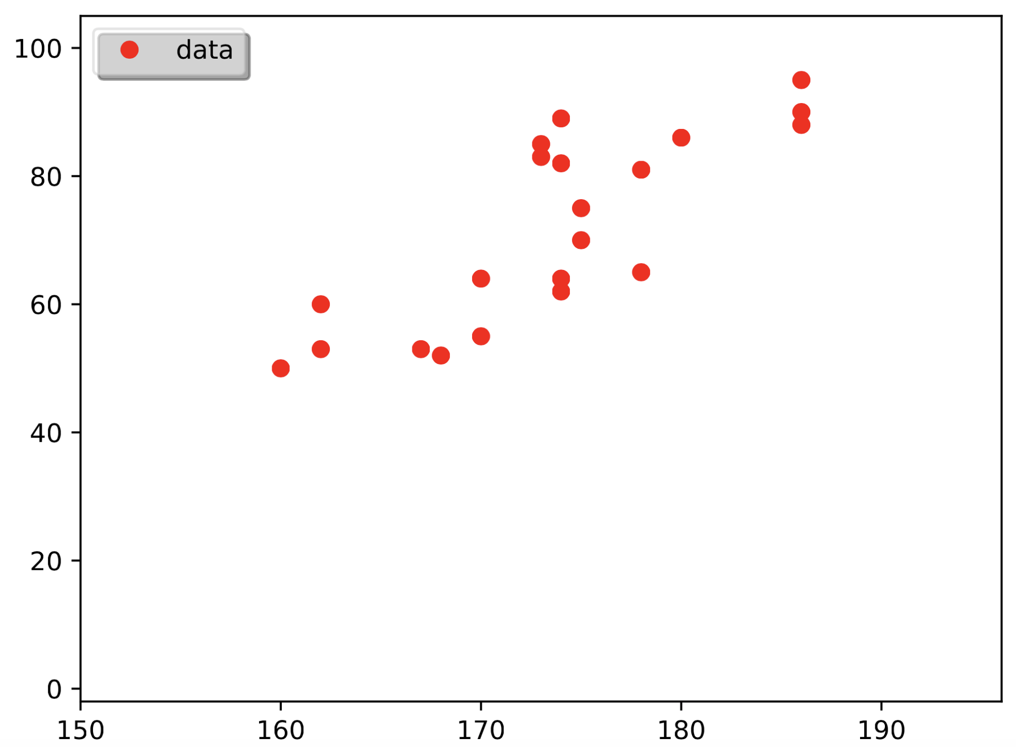
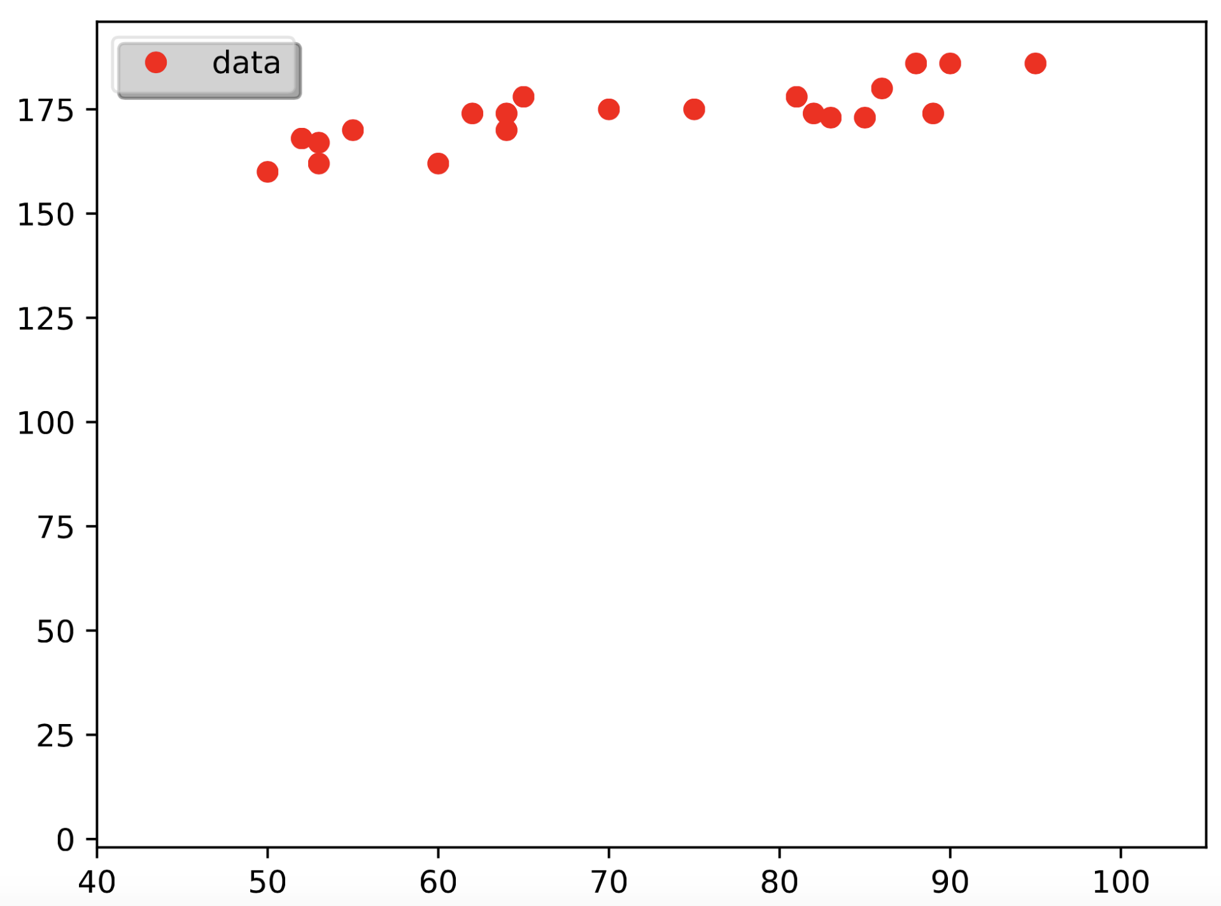
1. Task
Plotted without the outliers
data = data[np.all(data[:,0:2].astype(float)>0,axis=1)]

Slide 5
2. Task

Slide 6
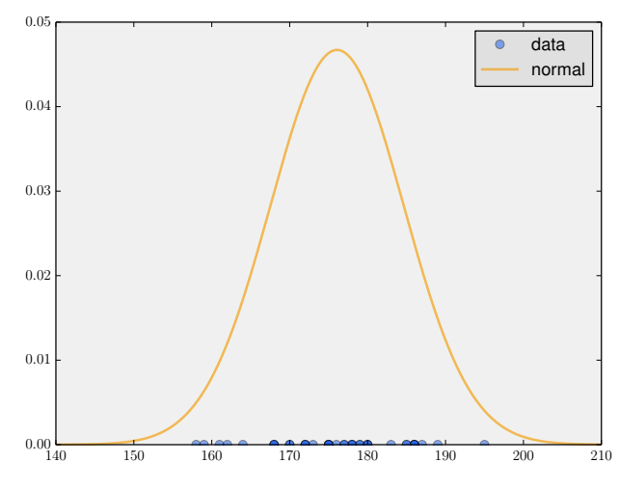
2. Task
Consider the 1D array of data
Compute mean and standard deviation
Plot the data and a normal distribution characterizing its density

Slide 7
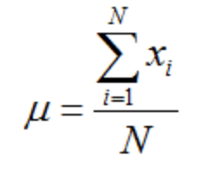
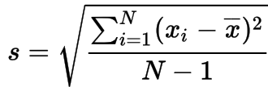
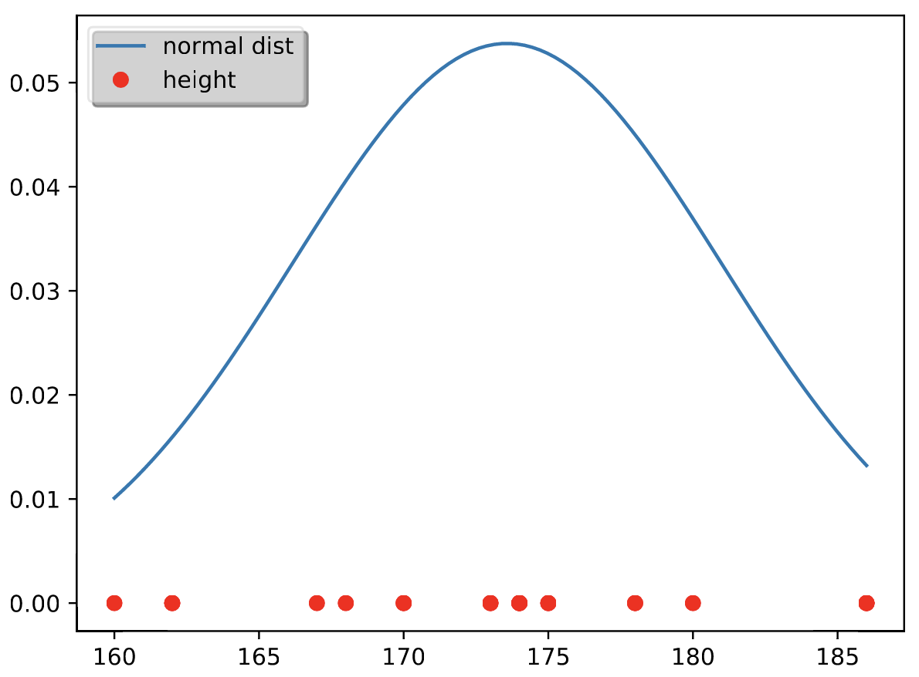
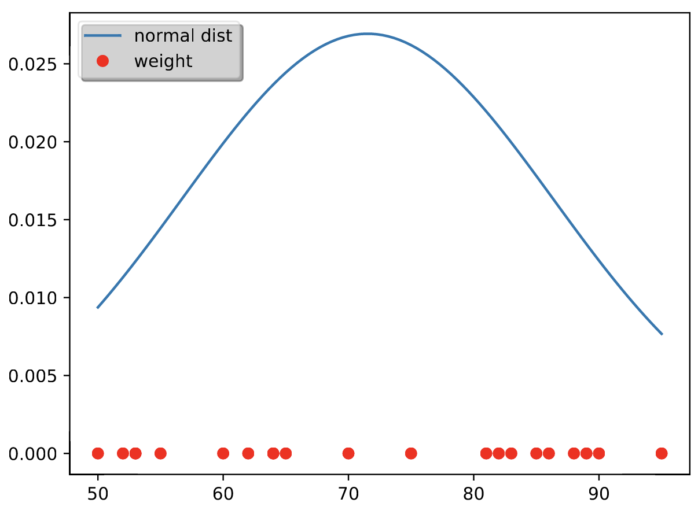
2. Task
Mean: standard deviation:

Slide 9
3. Task

Slide 10
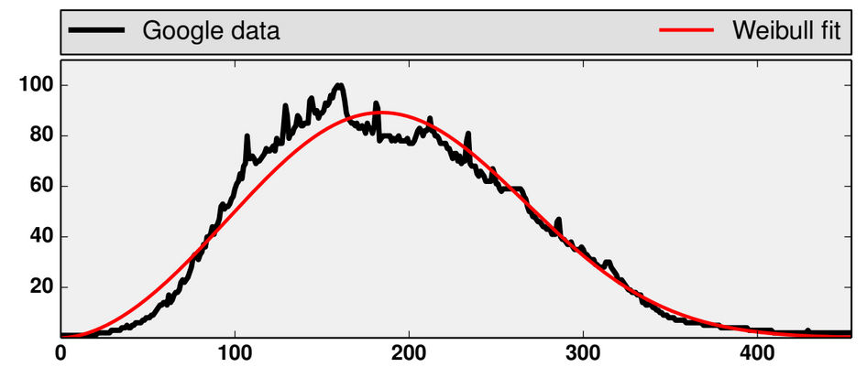
3. Task
Fit weibull distribution
to given data
Estimate parameters
and by
maximum likelihood

Slide 11
3. Task – Using histogram
Use only the histogram data and not the whole
Small example:
is the absolute frequency
is the set of all possible values

Slide 12
3. Task – Using histogram
Sum over D:
Sum over function of D:

Slide 13
3. Task – Newton Method
Applied the method
from the task description
Tried more steps

Slide 14
Task 3 – ODE Method

Slide 15
4. Task

Slide 16
Exercise 5

